Slide 1
Top 10 strategies for ell students
Advancing academic language proficiency

Slide 2
There’s More to See
Canadian born ELL
Non-Canadian born ELL
L1 Literacy
Family Support
Cultural Background
Past experiences
Past educational experiences
Notes:
Who are our ELLs? Talk about where they come from. If the language spoken at home is NOT English- they are ELL. What factors will we need to look at when have ELL students in our classrooms. What do INTAKE meetings usually look like?
L1 literacy transfers: concepts, linguistic elements, phonological awareness, morphological awareness, strategies.

Slide 3
Basic Communication vs. Academic Language
2 years
Functional language skills
Basic Interpersonal Communication Skills (BICS)
Write and read
Insufficient
Cognitive Academic Language Proficiency (CALP)
5-7 years to develop*
Complex and takes time
Proficient in CALP
Notes:
Within 2 years of being integrated in a Canadian Classroom students develop functional language skills for carrying basic everyday conversations.
BICS- Kitchen language
When expected to deal with demanding content areas like reading a repository text or writing research papers, BICS in insufficient. A large gap between BICS and the language required for academic purposes.
CALP- is academic language proficiency, like the language we use in school (The focus of this workshop). Takes approx 5-7 years to develop and up to 8 years with adolescents.
To be proficient in CALP level of language, they must use English in an academic context as well as their native speaking peers.

Slide 4
BICS vs. CALP
Lectures
Specialized terminology
Reading
Humor
Metaphor
Analogy
Textbook language
Notes:
Types of things we do in the classroom that require CALP are: This workshop is designed to help us differentiate for these learners.
HANDOUT THE ATA PAMPHLET.
Any other CALP type things you can think of in your classrooms?

Slide 5
ELL learn best when they…
Are involved with what works best for them
Made aware of the available resources and choice/variety of materials
Given realistic expectations
Are acknowledged in their growth
Are in an environment where risk-taking is valued
Has a sense of self-confidence with peers and competence with day-to-day communication
Have opportunities to interact with English speaking peers as well as those who share a first language
Understand the new culture, clearly and show respect for its values while maintaining and valuing their own culture
Are both teachers AND learners, individuals AND group members
Notes:
Taken directly from the ESL Guide to Implementation Alberta Education 2007. Not much different from all learners.

Slide 6
Targets “What a child can do in his dominant language is the ceiling of what he can do in his second language” (Pransky, 2008)
To provide us with ‘right now’ strategies we can implement in our classrooms
To encourage further differentiation for all language learners
To gain knowledge around academic language proficiency
How can I support my English Language Learners in a content-based classroom?
Notes:
Our goals and question to be answered. Show Integrating ESL into the Classroom @ 12 minutes- 15 minutes.

Slide 7
What’s it like to lack CALP in the classroom?
http://www.youtube.com/watch?v=Vt4Dfa4fOEY
Notes:
Clip and the other example is the Jaberwok poem

Slide 8
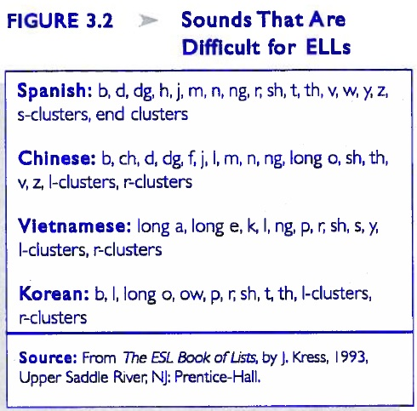
Strategy #10 Alpha-Play
Alphabet Boxes
Loud letters
Magic letter
Metalinguistic Awareness
Notes:
Pass out alpha boxes:
Draw on the board winTer and scarF doG etc.
Difficult sounds for ELL students (Figure 3.2)

Slide 9
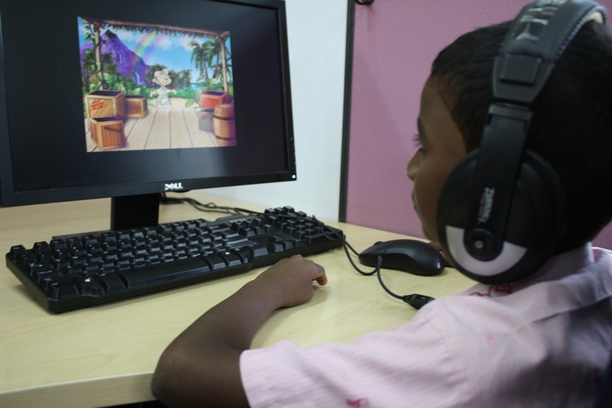
Strategy #9 Assistive Technology
Imagine Learning Program
Lexical Tutor
Beware
Notes:
Show a sample of IL
http://www.lextutor.ca/

Slide 10
Strategy #8 Games
Classroom feud
What is the question?
Create a category
Where/who am I?
Notes:
Classroom feud is in the vocab games book pg. 167
What is the question? P. 117
Create a category p. 89
Where am I pg. 85

Slide 11
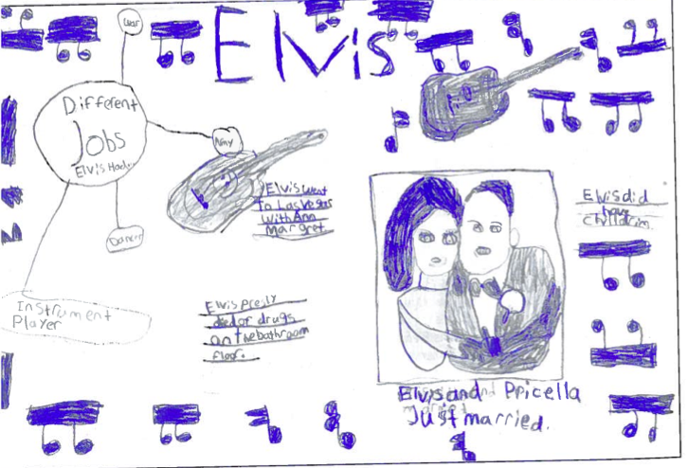
Strategy #7 Non-Fiction
Bring realia into the classroom
Familiarity with non-fiction characteristics (What do you already know about the topic and questions you have before you begin)
Fact-Question-Response
SQ4R (Survey, Question, Read, Recite, Record, Review or Re-read)
Notes:
Non verbal information can be helpful in making content understandable.
Elvis example pg. 161 of Harvey

Slide 12
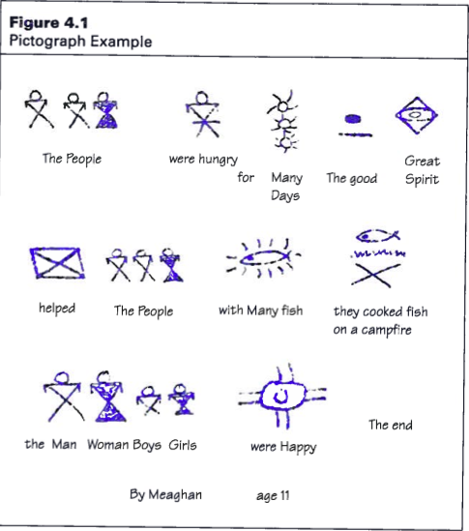
Strategy #6 Notes
Post-its
Combination notes
Thick and Thin questions
Notes:
Focus on what is important- keep it concise.
Combo notes- page 73, 74, 75
Thick and Thin- small post it notes and large ones- Thin (Word question, add to dictionary, etc) Think (A question that requires an answer in order to comprehend).

Slide 13
Strategy #6 CONT
Notes:
Focus on what is important- keep it concise.
Combo notes- page 73, 74, 75
Thick and Thin- small post it notes and large ones- Thin (Word question, add to dictionary, etc) Think (A question that requires an answer in order to comprehend).

Slide 14
Strategy #5 Connections
Provide a description, explanation or example of the new term
Ask student to restate the description, explanation in their own words
Ask student to construct a picture, symbol or graphic representing the term
Engage students periodically in activities that help them add to their knowledge of terms in their notebooks
Periodically ask students to discuss the terms with one another
Involve students periodically in games that allow them to play with terms (Marzano & Pickering, 2005, 14-15)
Implement a process for teaching new terms
Real-Life
Clear language and content goals
“It reminds me of…”
Vocabulary self-awareness
Dual Language Books
Notes:
Real-life: Read Marshall Memo excerpt oct 2013 pg. 7-8
Add in Marzano’s rubric around learning goals?
Vocab self-awareness- I know that word, I don’t know that word, that word sound like or sounds familiar

Slide 15
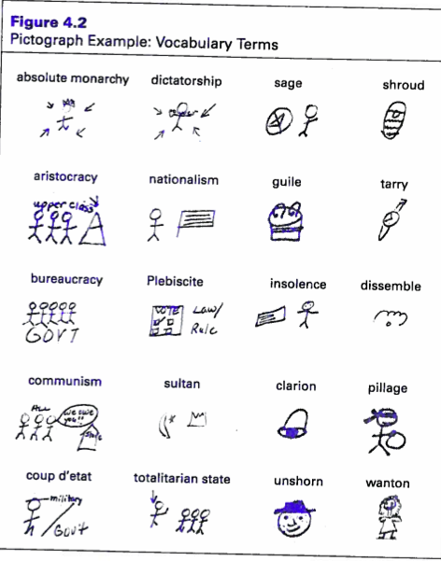
Strategy #4 Pre-teaching
Question before a lesson begins
Preview texts
Notes:
“Research shows that using questions before a learning experience can serve to activate and access prior knowledge” (Hill & Flynn 2006) pg. 46.

Slide 16
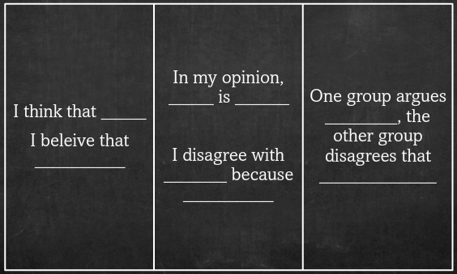
Strategy #3 Word Studies
Language frames
3rd grade onwards 2500 to 3000 words per year.
Using cognates
Teaching ‘root words’
Shades of words
Explicit instruction of words- charts
Word banks (Pg. 23 of Shifferdanoff)
Notes:
The more words you know the better you do in school (Deborah Short)
This includes word families like run, running run over, etc. May include First I…… then I……. Last I ……. I can…. I can’t ……
Language Frames- orally use and written
Have every do and present a shade of word color
Practice new words _at least 12__ times to have students know it well enough to improve comprehension

Slide 17
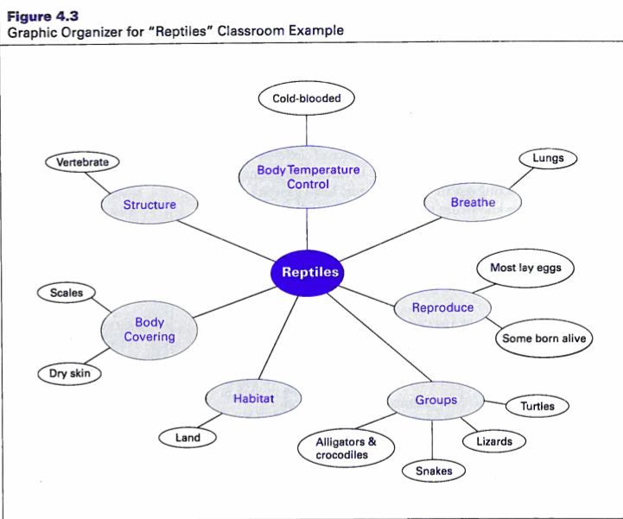
Strategy #2 GRAPHIC ORGANIZERS
Frayer Model
Vocabulary list
Notes:
Add scanned JPG from pg. 65 of Pransky

Slide 18
Strategy #1 VISUALS
Processing time on visuals
Definition 4 square
Pictographs
Storyboards
Vocabulary walk or a gallery walk
Positioning pictures
“When comprehensible input occurs within meaningful activity, we acquire language more easily, and providing comprehensible input is essential for teaching subject matter to ELL” (Pransky, 2008, 35)
Notes:
Get started with ELL ( 9:30- 13:00)
Visuals are processed 60 000 times faster than text alone.
Pictographs- figure 4.1 and 4.2 pg. 39 and 40 of Hill & Flynn
Positioning pictures- enlarged picture of these as an example
Gallery walk- winter (visuals are all from that category).

Slide 19
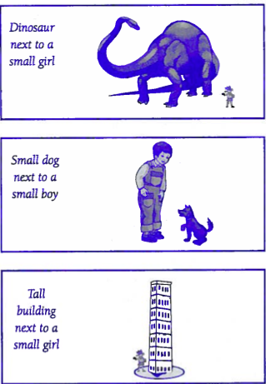
Targets “What a child can do in his dominant language is the ceiling of what he can do in his second language” (Pransky, 2008)
How can I support my English Language Learners in a content-based classroom?
To provide us with ‘right now’ strategies we can implement in our classrooms
To encourage further differentiation for all language learners
To gain knowledge around academic language proficiency
Notes:
Revisit Targets. Ask for feedback on a survey

Slide 20
Enjoy! Eslc.teachers.ab.ca
Notes:
Invite participants

