Slide 1

Reading
Strategies to Support ELLS
Teresa Borchers
2013 ESL Conference
teresa.borchers@rdcrs.ca

Slide 2

What do you believe effective reading instruction looks like for ELLs?

Slide 3
Important Considerations
Gradual release of responsibility
Thinking aloud
Clear purpose for reading
Explicit teaching in reading strategies
Testing vs teaching comprehension
Opportunities for purposeful talk
Pre-teach meaningful vocabulary
Making connections
Differentiated Instruction

Slide 4
TEACHER RESPONSIBILITY
Explicit Instruction
“I do it”
Guided Instruction
“We do it”
Collaborative
“You do it
together”
Independent
“You do it
alone”
STUDENT RESPONSIBILITY
A Structure for Instruction that Works
© Fisher & Frey, 2006

Slide 5
Three-Part Learning Framework
Before Reading
Set clear purpose for reading
Identify text structure
Make connections to prior knowledge
Explore questions, beliefs, predictions
During Reading
Learn information and vocabulary
Help construct meaning
Self-monitor comprehension
Ask questions, make connections
Keep reader engaged in reading
After Reading
Deepen/expand understanding
Explore text features and vocabulary in greater detail.
Reflect and share thinking/ideas

Slide 6

Before Reading
Clear Purpose
Anticipation Guides
Tea Party

Slide 7

Clear Purpose for Reading
Identify what students are reading and why
Allows students to adjust their reading pace
Allows students to focus their attention while reading
“Without knowing what kind of text we are reading or what we were expected to do with the information, we have no idea what to attend to” ASCD

Slide 8

Purposes for Reading
Find specific information
Make a comparison
Define an important term
Verify or disprove a belief
Determine key ideas
Make a connection to the ideas/events
Identify a personal opinion of the topic
Develop a key question on the topic

Slide 9
Textcompactor.com
Science Focus Topic 2 Notes: Human Impacts on Ecosystems
Natural Resources are the materials and products that are found in nature, that people use to meet their basic needs. How we are able to satisfy these needs with minimal conflict will determine how resourceful we can be.
People and Nature - A Changing Relationship
The ways people interact with the environment has changed over time. All of the needs people had in the past were satisfied by the natural resources they were able to find in the environment around them. The impact of this activity is significant, because cattle waste can pollute the water system nearby, and the soil conditions can be negatively affected.
When Is a Need a Want?
Needs are basic to survival, whereas, ' wants ' are things that just make survival more comfortable or enjoyable. Each time a need or a want is satisfied, natural resources or energy are used up. The new growth after a fire becomes food for elk, deer and other animals that need these nutrients from the forest floor.
Knowing what effects you are having on the environment (or will likely have) will help you make decisions.

Slide 10
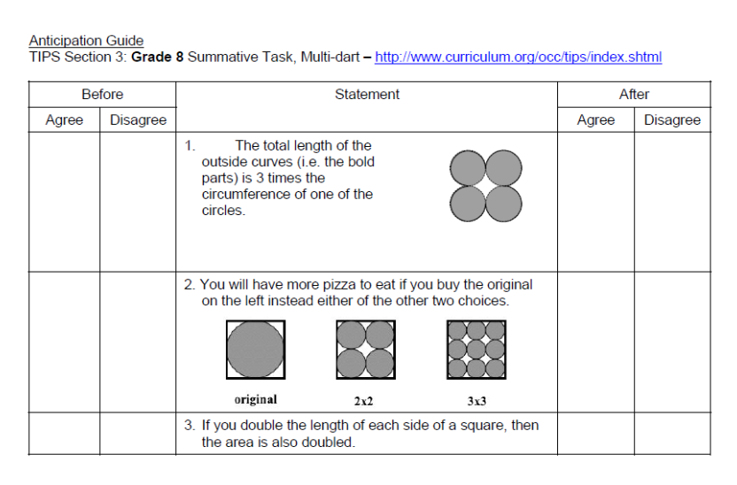
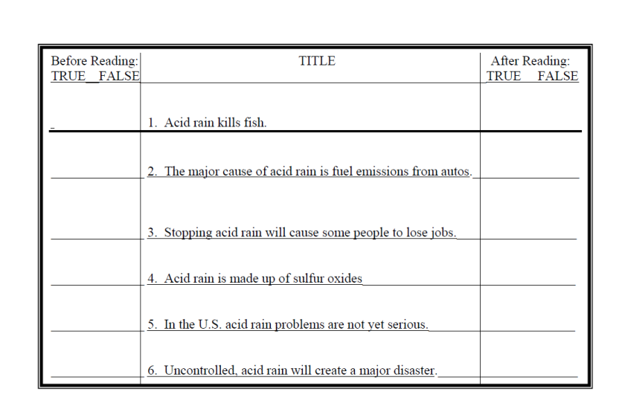
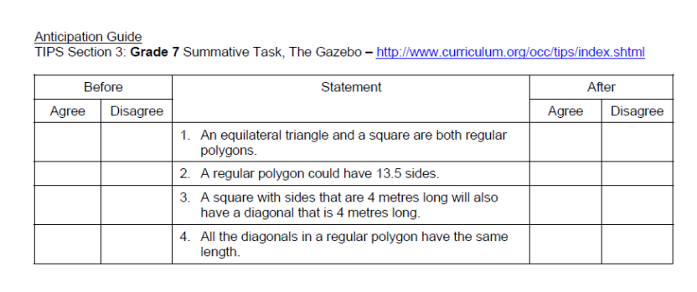
Anticipation Guides
Science
Math

Slide 11
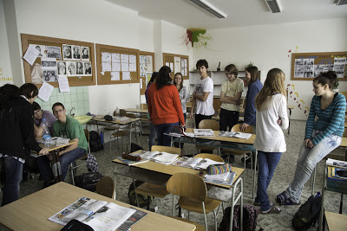
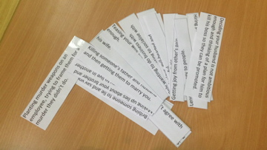
Tea Party

Slide 12

During Reading
4 Square Reading/Textbook Circles
Text Codes
Double Entry Journal

Slide 13
Textbook Circles
Roles can include:
    Discussion Director – identify key topics important for further discussion
    Connector – Find connections between reading and our world
    Questioner – Creates questions related to the reading
    Passage Master – Identify key sentences/paragraphs group should look back at, noticing what is interesting, puzzling, important, etc.
    Word Finder – Identify especially important words – new, interesting, strange, important, etc.
    Illustrator – Create a visual related to the reading (timeline, web, cartoon, diagram, flowchart, etc.)
    Researcher – Digs up any background information related to the topic in the reading

Slide 14
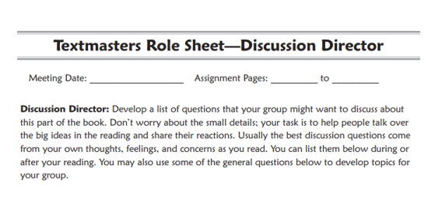
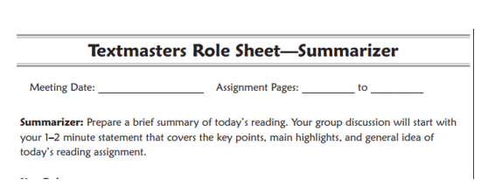
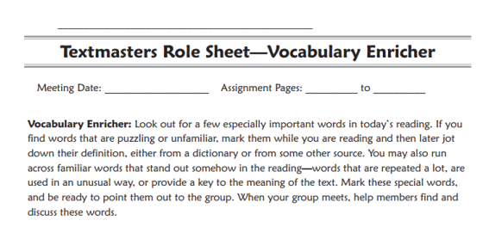
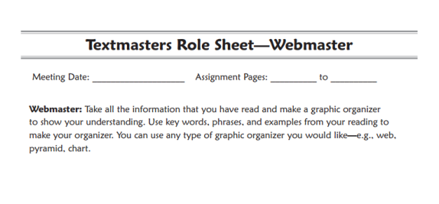
Textbook Circle
Role sheets
http://www.readwritethink.org/

Slide 15
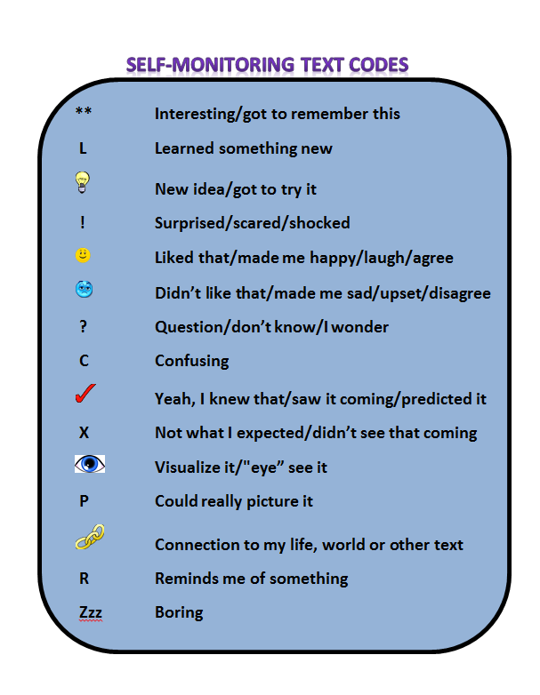

Text Codes

Slide 16
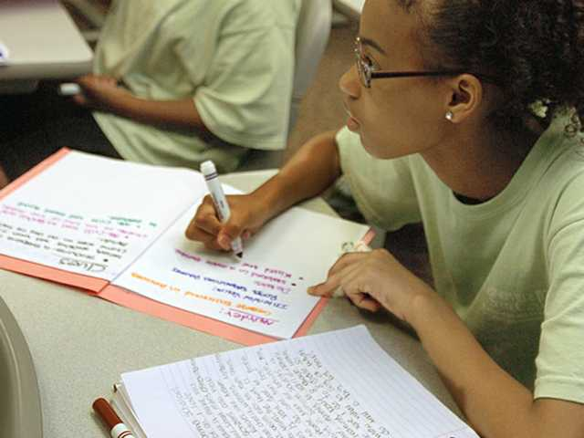
Note Taking/Making Skills

Slide 17
Double-Entry Journals
The Source/In the Book | The Response/In My Head
Key words | Questions, Importance Definitions, Visuals Prior Knowledge, Connections
Quotes/Phrases (that spark your interest, you can connect with, inspires further questions or are important) | Connections Questions Predictions, Inferences Interpret meaning of text Analyze details and purpose Evaluate by giving your opinion

Slide 18
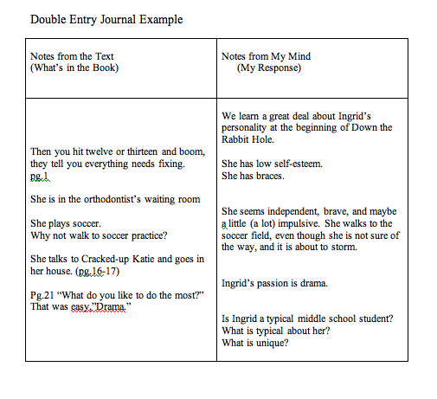
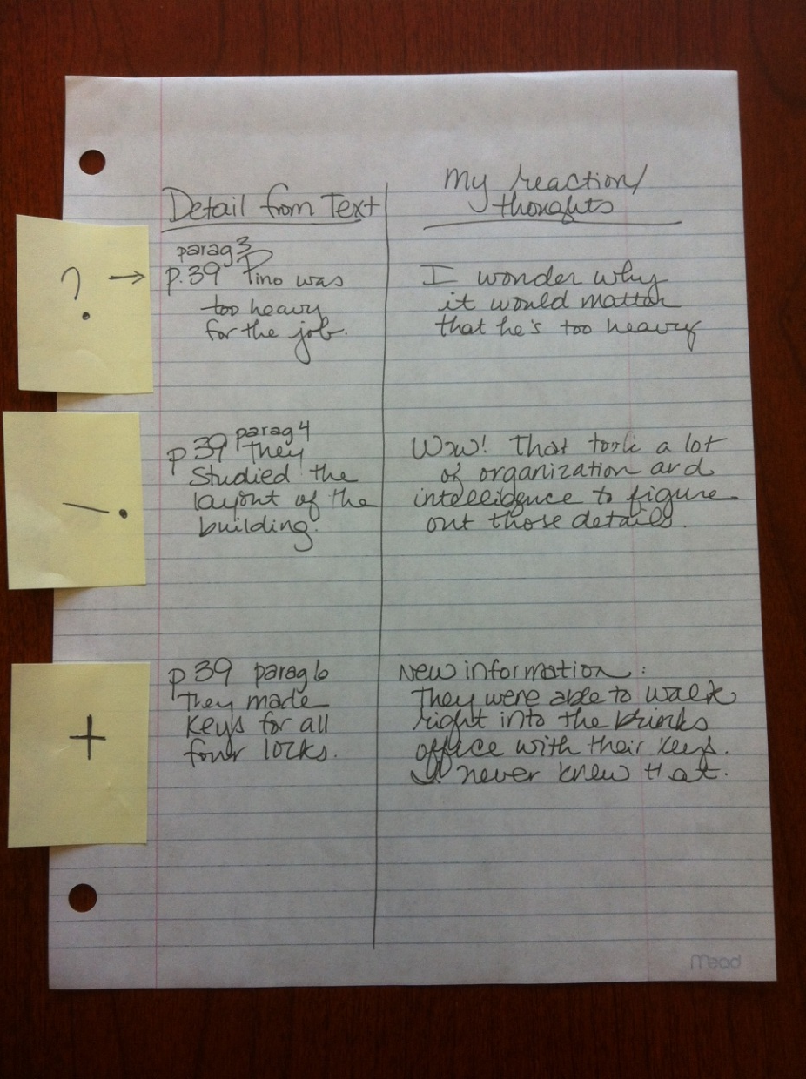
Note-Taking Samples

Slide 19

After Reading
Save the Last Word for Me
Frayer Model
Write Around

Slide 20
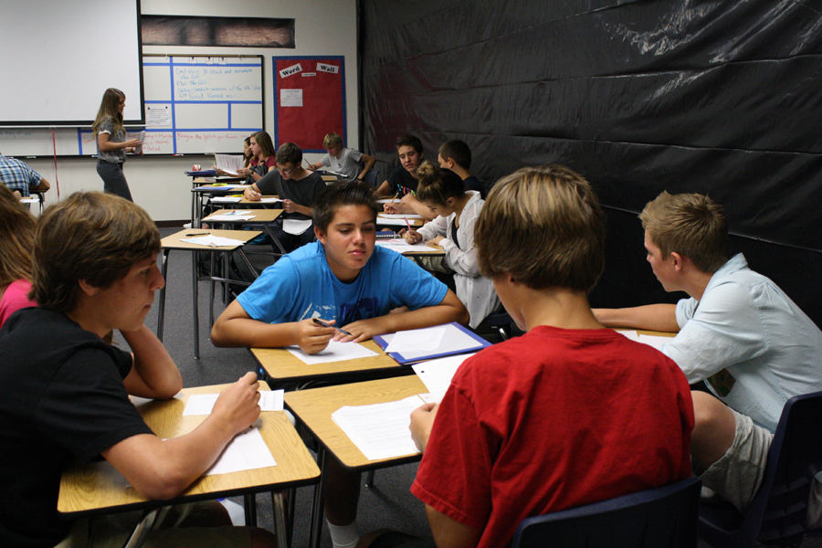
Save the Last Word for Me

Slide 21
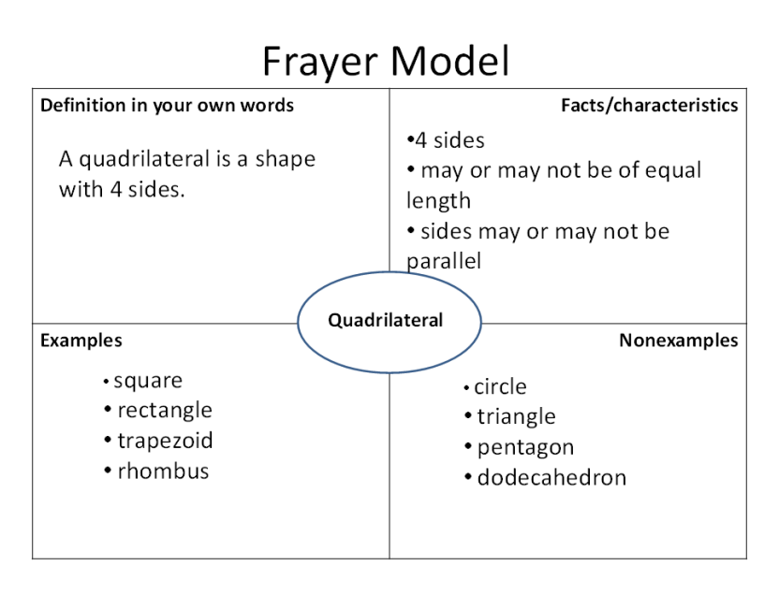
The Frayer Model

Slide 22
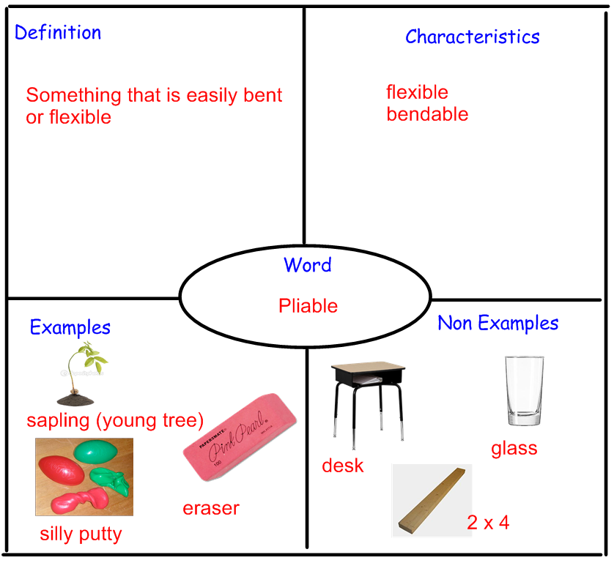
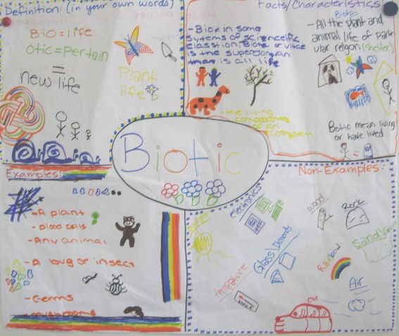

Slide 23

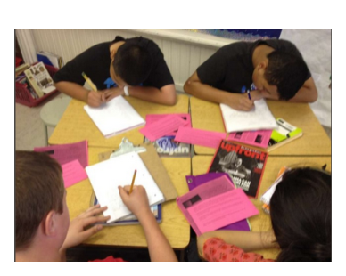
Write Arounds

Slide 24

What is one strategy you would like to try?

Slide 25
Reading Comprehension Strategies
Identify “what good readers do”
Explicit instruction
Use of visual/metaphor
Importance of modeling and thinking aloud (showing vs telling)
Teach in different settings
Teaching one in insolation vs more than one at a time
Common language, common process

Slide 26
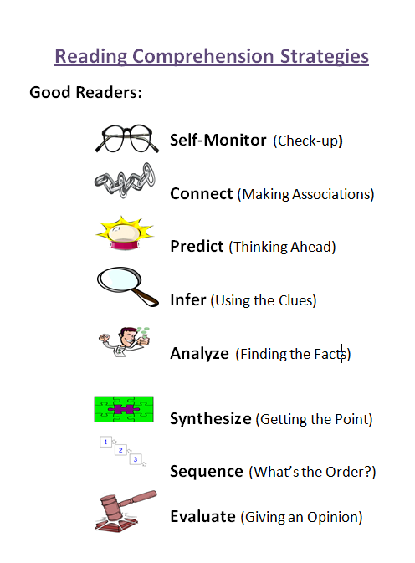
Reading Comprehension Strategies

Slide 27
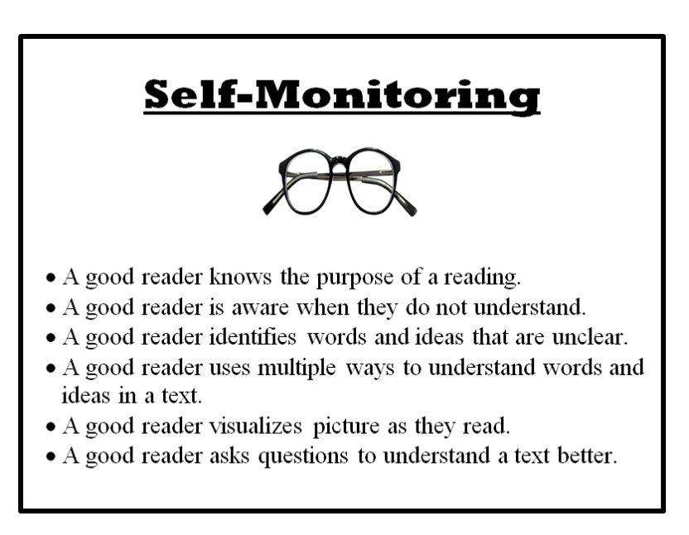
Explicit
Strategy Instruction

Slide 28
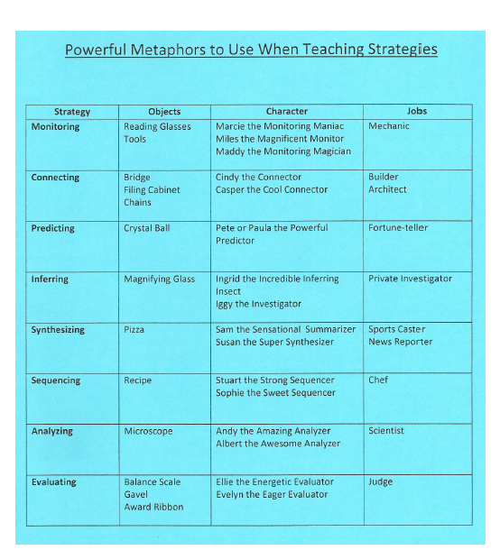
Strategy Metaphors
Object
Character
Job
Adapted from Lori Oczkus

Slide 29
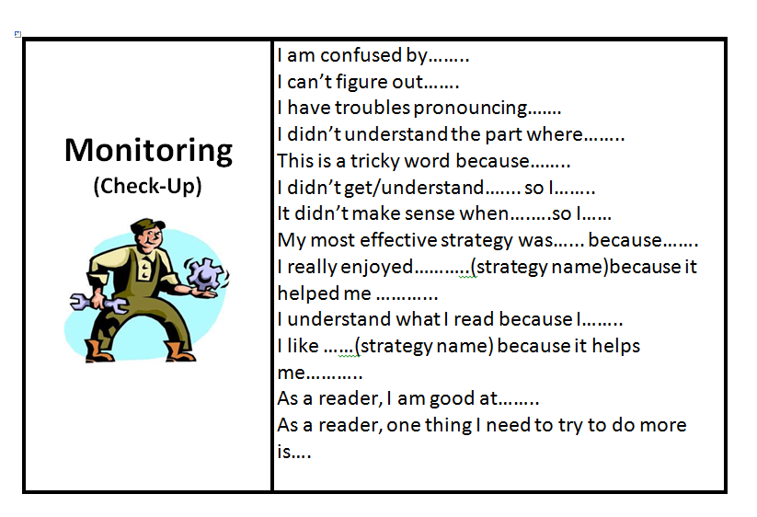
Explicit
Strategy Instruction – Think Alouds

Slide 30
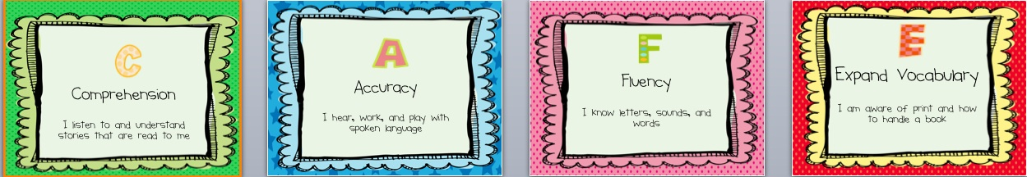
Strategy Support for the Classroom

Slide 31
Supporting Reading Instruction
Interest Inventories
Read alouds
Independent reading
Rich classroom library
Choice in what they read
What does reading look like?
Conferencing

Slide 32




Good Fit Books
Primary
Intermediate

Slide 33


Slide 34
Thank You!
teresa.borchers@rdcrs.ca

