Slide 1
Assessing Vocabulary Development in Upper Elementary Writing
Brock J. Wojtalewicz
MA Candidate
University of Calgary
Alberta Teachers’ Association ESL Conference
November 15th, 2013
Red Deer, AB

Slide 2
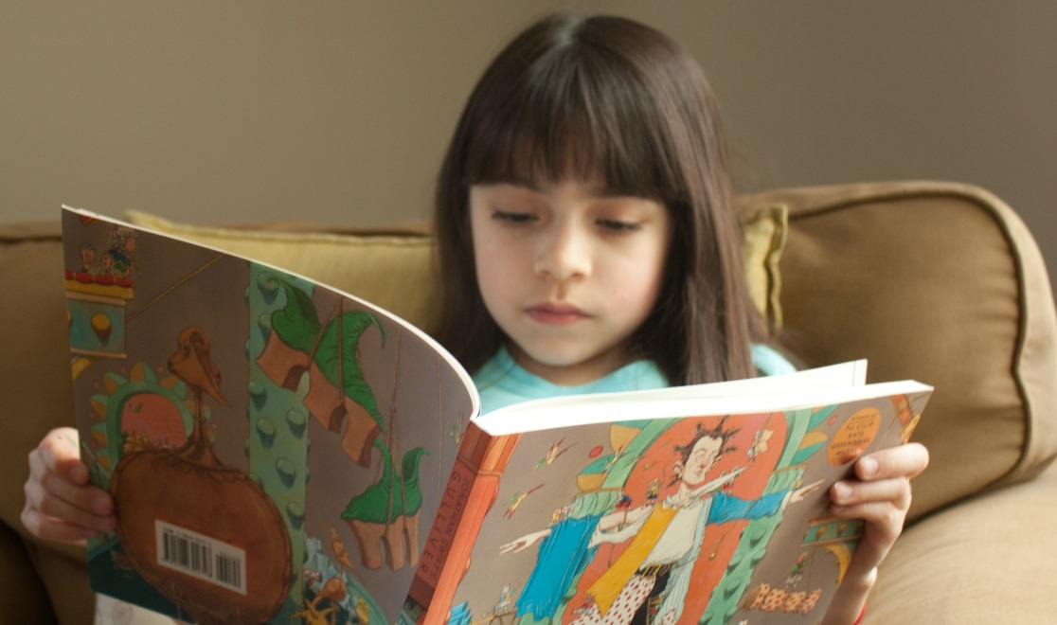
End of Grade 3/Beginning of Grade 4 = Critical Threshold in Literacy Development
Early literacy skills acquired (phonemic awareness, printing, spelling, etc.) (Gentry, 2002)
Transition from:
“learning to read”
“reading to learn”

Slide 3
The Role of Academic Vocabulary
Increased academic and lexical demands
(Biemiller, 2004)
Words of Greek and Latin origin (Corson, 1997)
Tier II and Tier III words (Beck, McKeown, and Kucan, 2008)
Avoiding the “Fourth Grade Slump” (Chall & Jacobs, 2003)

Slide 4
Vocabulary has been underrated in curriculum planning and assessment.
Important for reading comprehension, but what about writing? (Nation, 2006; Coxhead, 2006)
PAT – 14% of overall assessment rubric
How do we assess vocabulary development in learners’ writing?
Traditional assessment = intuitive and subjective

Slide 5
What is Vocabulary or Lexical Profiling?
Assessment tool for evaluating vocabulary
Based on word frequency
Quantitative approach
More objective; less subjective / intuitive

Slide 6
Online vocabulary profiling tools:
Compleat Lexical Tutor
Website developed by Tom Cobb – University of Quebec at Montreal
Freely available at: www.lextutor.ca
VP-Kids developed by Cobb and Roessingh: www.lextutor.ca/vp/kids

Slide 7
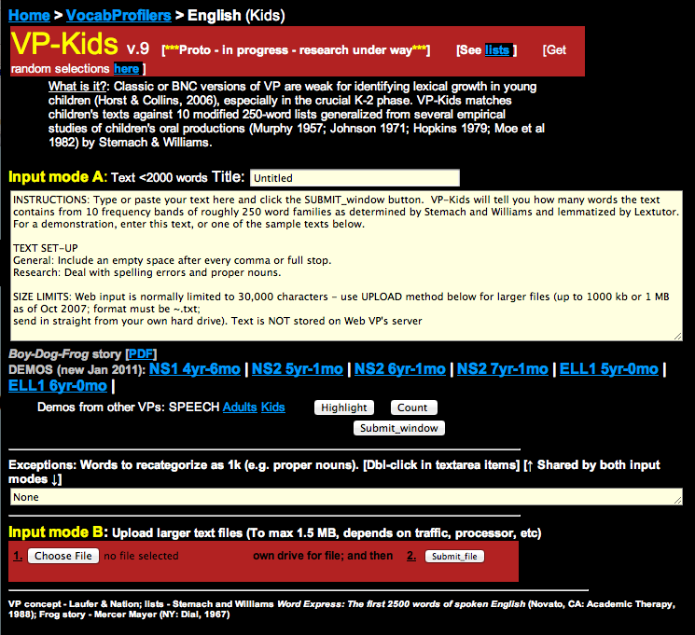
The Compleat Lexical Tutor www.lextutor.ca

Slide 8
Example of a Vocabulary Profile

Slide 9
Measuring Productive Vocabulary
Indices:
Total Number of Words
Number of Different Words
Type-Token Ratio
Coverage at Band 1
Coverage at Band 4
“Lexical Stretch” (How many bands?)
Off-list words

Slide 10
Grade 4 Writing Samples
Expository writing prompt: “Healthy Living”
Persuasive in nature; target audience = committee of teachers and parents
Elicits more diversity of vocabulary and academic language than narrative prompts

Slide 11
Holistic Marking Using a Trait-Based Rubric
Evaluate student writing samples and give a mark:
1 = Limited
2 = Adequate / Satisfactory
3 = Proficient
4 = Excellent

Slide 12
Trait-Based Rubric

Slide 13
Let’s compare our results!
(Discussion)

Slide 14
Now let’s look at the vocabulary profiles.

Slide 15
Sample B: Limited (1+)

Slide 16
Sample A: Adequate (2)

Slide 17
Sample C: Proficient (3-)

Slide 18
Sample D: Proficient (3+)

Slide 19
Sample E: Excellent (4)

Slide 20
Comparison Table
 | Sample B 1+ Limited | Sample A 2 Satisfactory | Sample C 3- Proficient | Sample D 3+ Proficient | Sample E 4 Excellent
TNW | 73 | 198 | 253 | 442 | 379
NDW | 50 | 94 | 115 | 200 | 190
Type-Token | 0.68 * | 0.47 | 0.45 | 0.45 | 0.50
Band 1 | 86.30% | 71.72% | 69.17% | 68.33% | 61.64%
Band 4 | 93.15% | 87.38% | 82.61% | 83.94% | 77.57%
Off-list | 2 word fam. | 8 word fam. | 17 word fam. | 24 word fam. | 24 word fam.
Examples of academic, rare, and specialized vocabulary | video active (from prompt) | nutrition posture device | survey appropriate required consisting challenge donate obstacle | replacing console encourage supervision flexible invest factor encounter | opinion reinforce combination popular involve offer suggestion inspire

Slide 21
New Directions:
My Research Project

Slide 22
Developing a New Vocabulary Profiling Tool for Upper Elementary
Based on written texts reflecting the academic demands of Grades 4, 5, and 6
Representing diverse content areas (math, science, social studies, and language arts)
The new vocabulary profile will be available online at no cost.

Slide 23
Closing Remarks
Vocabulary needs more attention in curriculum planning and language assessment.
We can do better measuring vocabulary use and development longitudinally; we have tools/resources.
Academic lexis should be taught in early years; elementary learners are up for the challenge!
Expository writing can be introduced early on.
Direct, explicit teaching of academic vocabulary is crucial.

Slide 24
We need to equip our learners with the academic language they will need to succeed!

Slide 25
References (1/2)
Beck, I., McKeown, M., and Kucan, L. (2008). Creating robust vocabulary: frequently asked questions and extended examples. New York: The Guilford Press.
Biemiller, A. (2004). Teaching vocabulary in the primary grades: Vocabulary instruction needed. In J.Baumann & E. Kame’enui (Eds.), Vocabulary instruction: Research to practice (pp. 28-40). New York: The Guilford Press.
Chall, J. S., & Jacobs, V. A. (2003). The classic study on poor children’s fourth grade slump. American Educator, Spring, 2003. Retrieved from http://www.aft.org/newspubs/periodicals/ae/spring2003/ hirschsbclassic.cfm

Slide 26
References (2/2)
Cobb, T. and Roessingh, H. (2007). Compleat Lexical Tutor VP-Kids. http://www.lextutor.ca/vp/kids
Corson, D. (1997), The Learning and Use of Academic English Words. Language Learning, 47
Coxhead, A. (2006). Essentials of teaching academic vocabulary, Boston: Houghton Mifflin Company.
Gentry, J. R. (2002). The literacy map: Guiding children to where they need to be (4-6). NY: Mondo Publishing.
Nation, P. (2006). How large a vocabulary is needed for reading and listening? The Canadian Modern Language Review 63 (1), 59-82.

Slide 27
Acknowledgements
A special thank you to:
My supervisor, Dr. Hetty Roessingh
My colleague, Geoffrey Pinchbeck, PhD candidate
Social Sciences & Humanities Research Council (SSHRC): Insights & Development Grant

Slide 28
Thank you for your time and attention!
Brock J. Wojtalewicz
MA Candidate in Languages & Diversity
Werklund Faculty of Education
University of Calgary
email: bjwojtal@ucalgary.ca

